Slide 1

Online Learning Applications
Project assignment
Authors:
Balestrieri Niccolò, Bertogalli Andrea, Cavalieri Francesco, Tombini Nicolò
Professors:
Matteo Castiglioni, Gianmarco Genalti
Accademic year 2024/2025

Slide 2






OLA - Project Assignment
N. Balestrieri, A. Bertogalli, F. Cavalieri, N. Tombini
Introduction - The task
The goal of the project is to design online learning algorithms to handle a marketing campaign to sell products, including an advertising campaign and a pricing problem.
The setting is then:
For each day the company chooses a price $p$.
The company faces a sequence of auctions. For each auction:
The company chooses a bid $b$.
A slot is (possibly) assigned to the company depending on $b$, the competing bids, and the auction format.
If the ad is clicked, an user visit the company web page.
The user buy the company product with a probability that depends on the price $p$.
Company
Take part to
Pricing
Uses
won slots
Are sold
Auctions
Ad slots
Products
See
Buy
REFERENCES:
Project assignment, M. Castiglioni & G. Genalti, 2024.
Users

Slide 3
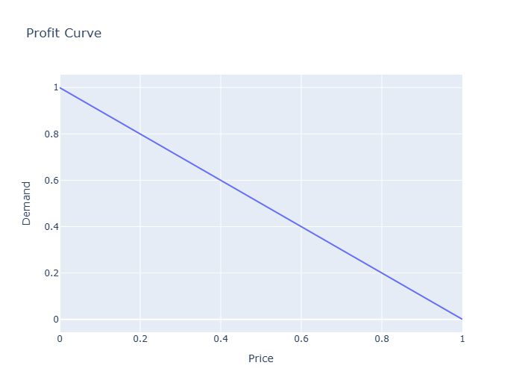
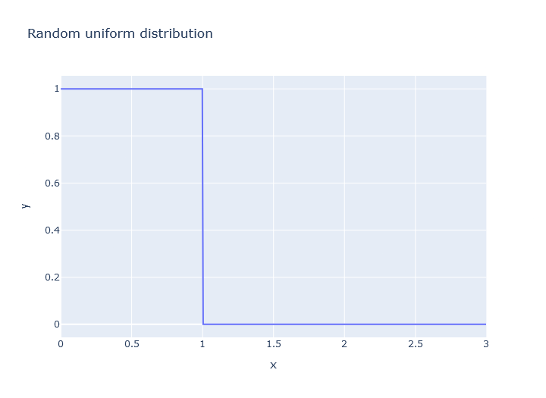
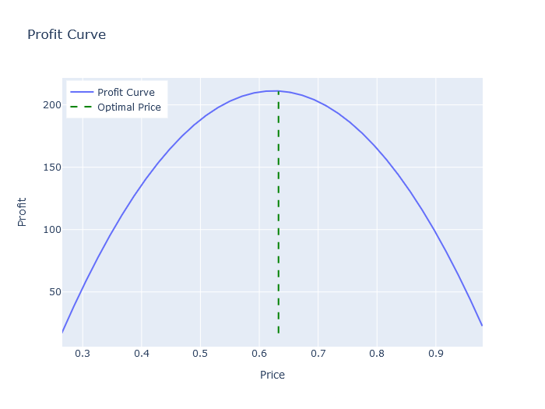
OLA - Project Assignment
N. Balestrieri, A. Bertogalli, F. Cavalieri, N. Tombini
Stochastic environment - The setting
Here we consider a stochastic environment, this includes a distribution over the bids of the other agents ($U(0,1)$) and a function specifying the probability with which an user buys for every price ($D(p)$). Here (but also in adversarial environments) we consider the probability $λ_{s}$ of a slot $s$ to be observed as constant. In particular considering a continuous set of prices $p∈[0,1]$ we employed GP-UCB for pricing, while for the bidding problem we considered a sequence of second price auction and employed a Multiplicative Pacing Strategy and a UCB-Like approach.
Fig. 1 - The demand curve which represent the conversion probability, in this case this function is modeled simply as $1-p$.
Fig. 2 - The distribution over competing bids, in a stochastic environment is modeled as a uniform distribution $U(0,1)$.
Fig. 3 - Clairvoyant profit curve representing the profit for each price, the profit is compute as $P=(p-c)⋅n_{t}$ where $n_{t}=D(p)⋅n_{c}$.

Slide 4
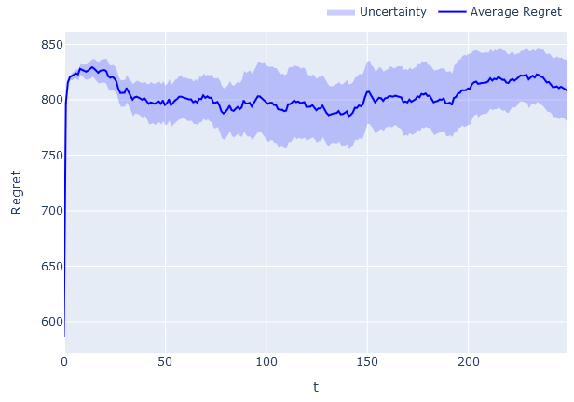
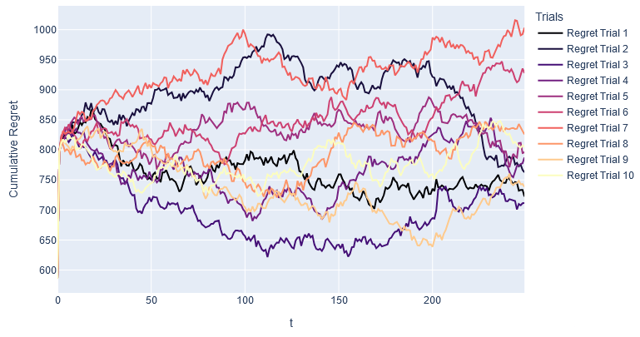
OLA - Project Assignment
N. Balestrieri, A. Bertogalli, F. Cavalieri, N. Tombini
Stochastic environment - Pricing GP-UCB
Here we employ GP-UCB over a continuous set of prices $p∈[0,1]$ considering the following parameters: the cost $c=0.25$, the number of rounds $T=250$, $K=50$, customers = 1500. The execution have been made over 10 trials.
Fig. 4 - The average regret achieved over 10 trials by GP-UCB.
Fig. 5 - The regret for every trial archived by GP-UCB.

Slide 5
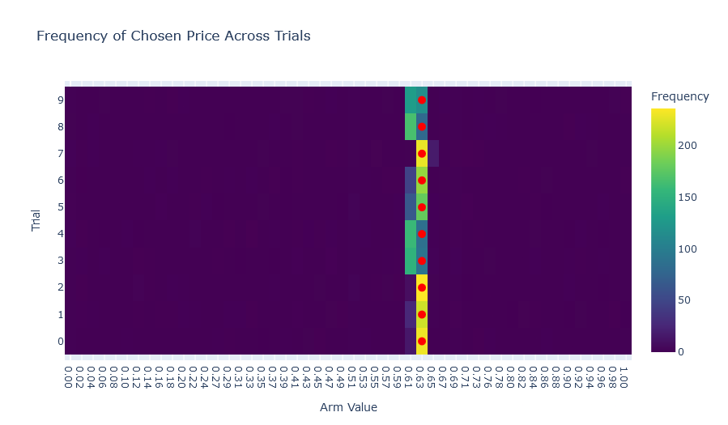
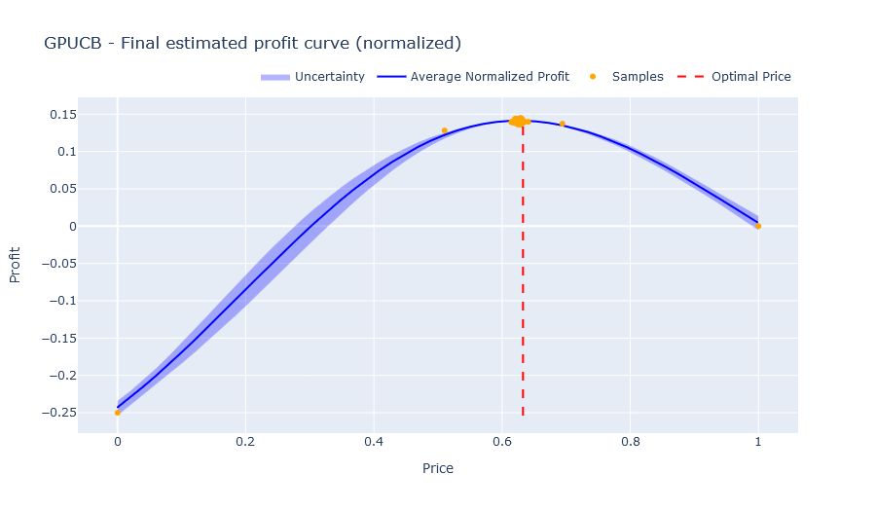
OLA - Project Assignment
N. Balestrieri, A. Bertogalli, F. Cavalieri, N. Tombini
Stochastic environment - Pricing GP-UCB
Here we inspect the chosen prices, as we can see the algorithm perform well (almost) converging to the optimal price. Notice that the heat map that we show is discretised for visualisation purposes.
Fig. 6 - The chosen prices frequency ($N(t)$) for each trial - GP-UCB.
Fig. 7 - Here we plot the final estimated profit curve (normalized), along with the chosen prices samples.

Slide 6
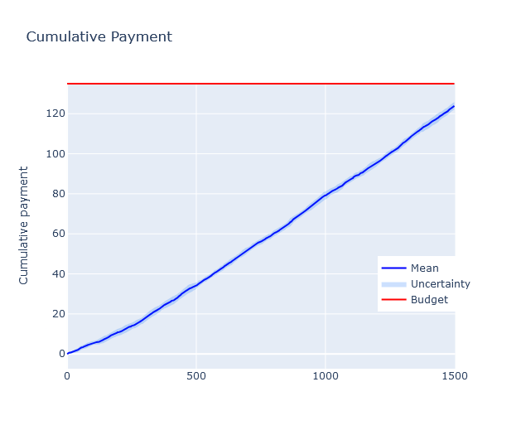
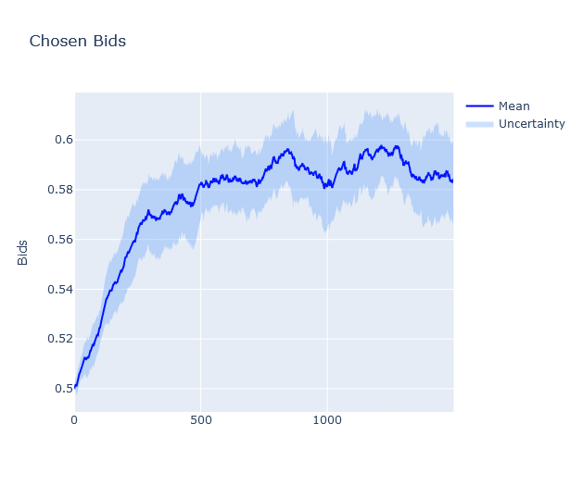
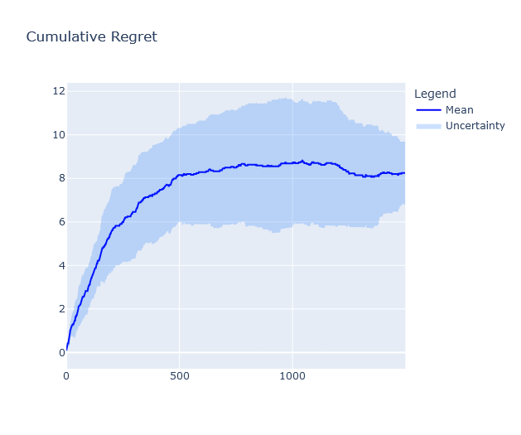
OLA - Project Assignment
N. Balestrieri, A. Bertogalli, F. Cavalieri, N. Tombini
Stochastic environment - Bidding multiplicative pacing
Here we employ a Multiplicative Pacing Strategy on the bidding problem in stochastic environment (shown in the previous slide). Here we consider the following parameters: the budget $B=135$, 3 advertisers, 1500 customers ($n_{c}=1500$), these results were obtained over 10 trials.
$$n_{c}$$
$$n_{c}$$
$$n_{c}$$
Fig. 8 - The cumulative payments over the users in red we have the budget.
Fig. 9 - The chosen bids curve.
Fig. 10 - The cumulative regret archived by the multiplicative pacing strategy.

Slide 7
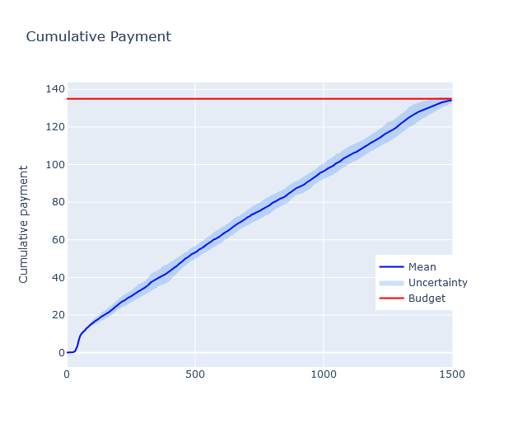
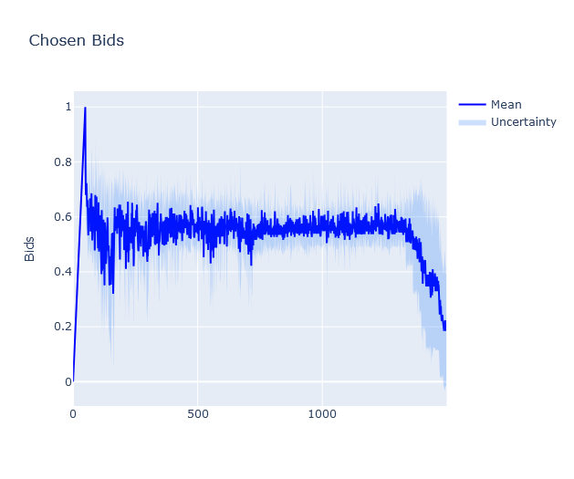
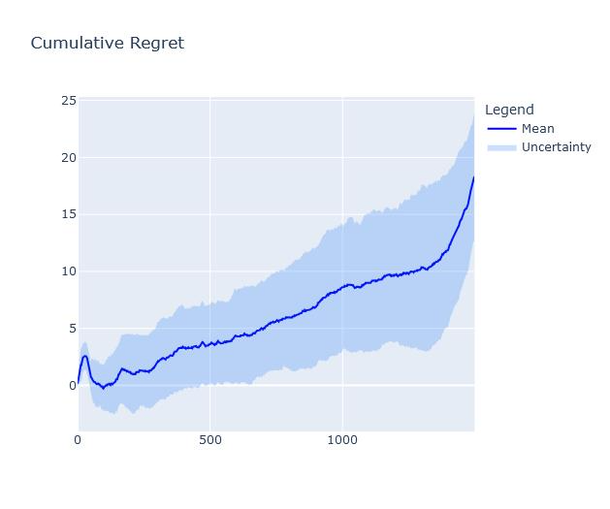
OLA - Project Assignment
N. Balestrieri, A. Bertogalli, F. Cavalieri, N. Tombini
Stochastic environment - Bidding UCB-Like
Here we
Here we employ a UCB-Like approach on the bidding problem in stochastic environment (shown in the previous slide). Here we consider the following parameters: the budget $B=135$, 3 advertisers, 1500 customers ($n_{c}=1500$), these results were obtained over 10 trials.
$$n_{c}$$
$$n_{c}$$
$$n_{c}$$
Fig. 11 - The cumulative payments over the users in red we have the budget.
Fig. 12 - The chosen bids curve.
Fig. 13 - The cumulative regret archived by the UCB-Like.

Slide 8
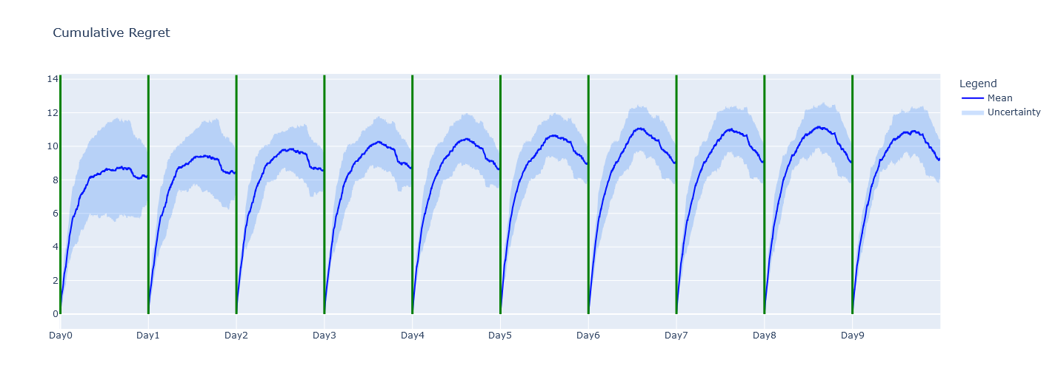
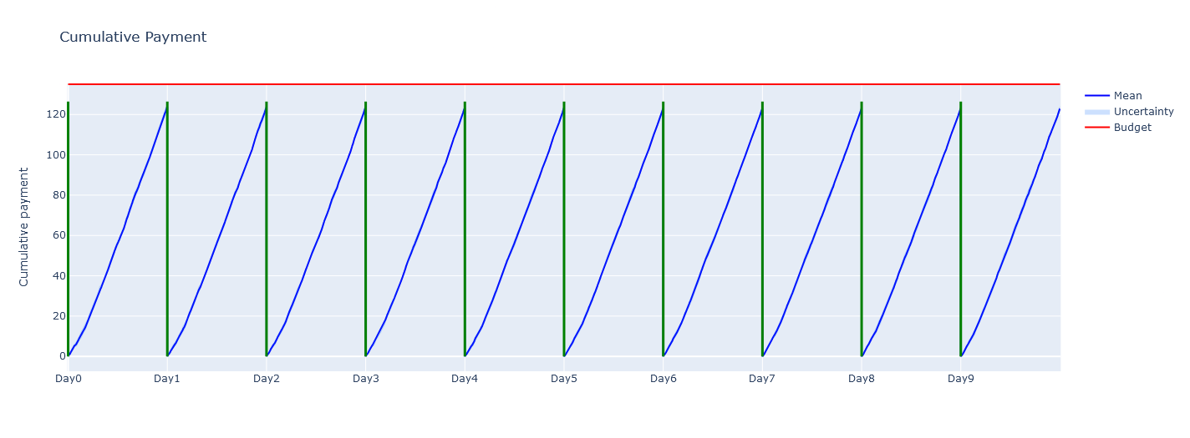
OLA - Project Assignment
N. Balestrieri, A. Bertogalli, F. Cavalieri, N. Tombini
Stochastic environment - Pricing + Bidding (MPS)
Here we evaluate Multiplicative Pacing Strategy for the bidding and GP-UCB for the pricing, with parameters: auctions = 1500, advertisers = 3, budget = 135, days = 10, trials = 10, cost = 0.25.
Cumulative regret
Fig. 14 - The cumulative regret in 10 days of pricing + bidding interaction.
Fig. 15 - The cumulative payments in 10 days of pricing + bidding interaction.

Slide 9
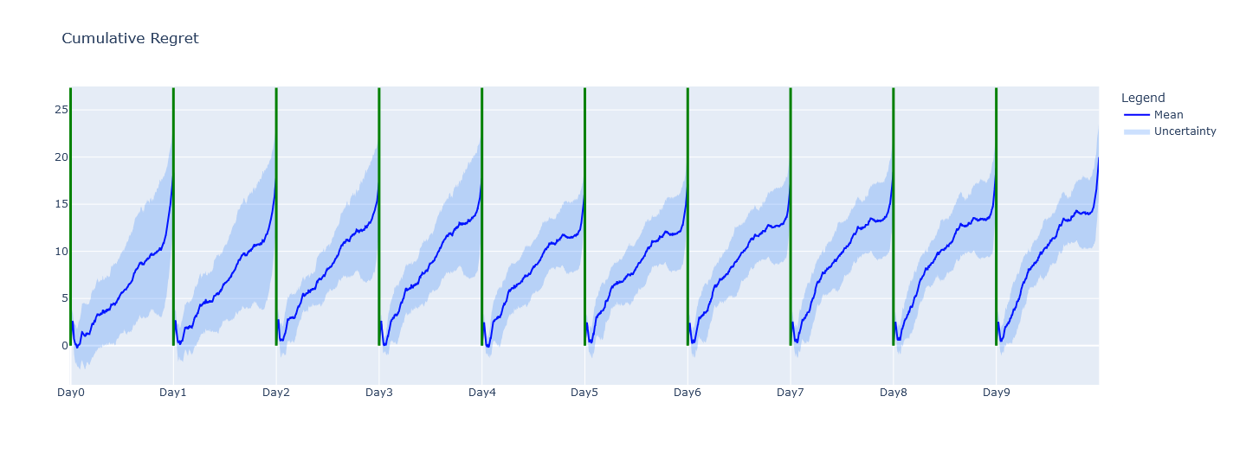
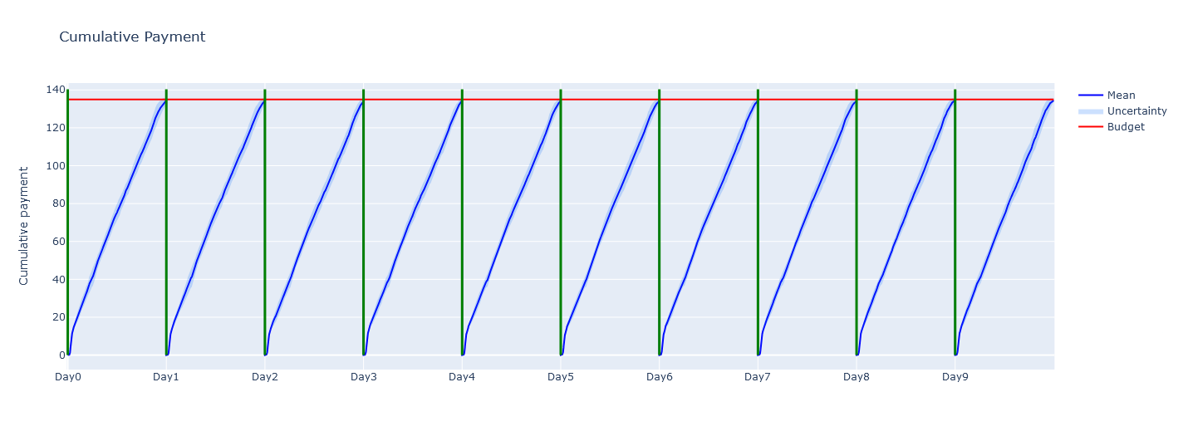
OLA - Project Assignment
N. Balestrieri, A. Bertogalli, F. Cavalieri, N. Tombini
Stochastic environment - Pricing + Bidding (UCB-Like)
Here we evaluate UCB-Like algorithm for the bidding and GP-UCB for the pricing, with parameters: auctions = 1500, advertisers = 3, budget = 135, days = 10, trials = 10, cost = 0.25.
Cumulative regret
Fig. 16 - The cumulative regret in 10 days of pricing + bidding interaction.
Fig. 17 - The cumulative payments in 10 days of pricing + bidding interaction.

Slide 10
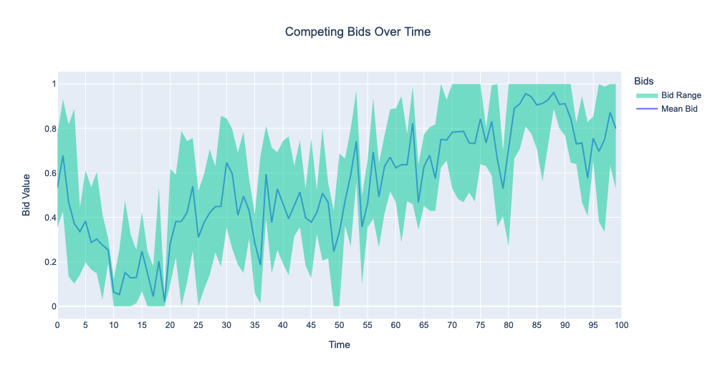
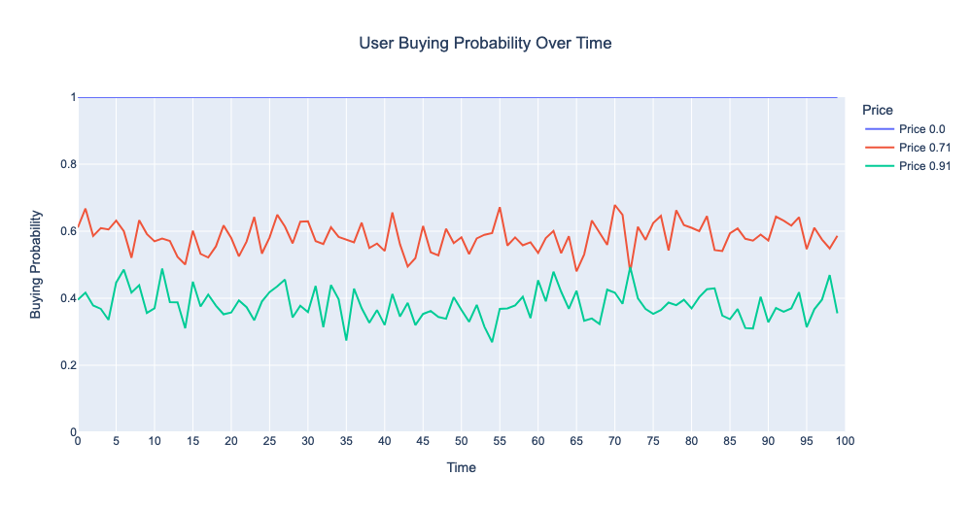
OLA - Project Assignment
N. Balestrieri, A. Bertogalli, F. Cavalieri, N. Tombini
Adversarial environment - The setting
Here we are considering an highly non stationary environment (modeled through a Gaussian Drift). In this setting we have a time-varying probability distribution over bids and a time-varying function which gives the user’s buying probability.
Users
Fig. 18 - The competing bids over time of the competing advertiser present in the auction $B(t)=N(μ_{t},0.2)$ where $μ_{t}=μ_{t-1}+U(i,j)$ and $i,j=±0.1$.
Fig. 19 - The buying probability over time for 3 fixed prices, as we can see the curve is oscillating, this is due to the change in the noise mean. This curve is defined as $D(t)=(1-p)+N(μ_{t},0.05)$ where $μ_{t}=μ_{t-1}+U(i,j)$ and $i,j=±0.005$.

Slide 11
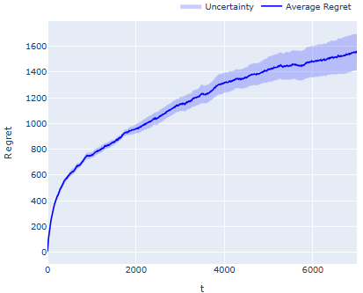
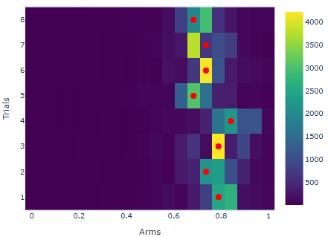
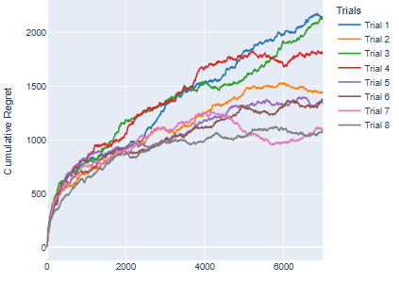
OLA - Project Assignment
N. Balestrieri, A. Bertogalli, F. Cavalieri, N. Tombini
Adversarial environment - Pricing EXP3
Here we employ EXP3 on discretized set of prices $p∈[0,1]$ considering the following parameters: the cost c = 0.3, the number of rounds T = 7000, K = 20, the number of customer = 30. The execution have been made over 8 trials.
Fig. 20 - The regret for every trial archived by EXP3.
Fig. 21 - The average regret archived over 8 trials by EXP3.
Fig. 22 - The chosen prices for each trials by EXP3.

Slide 12
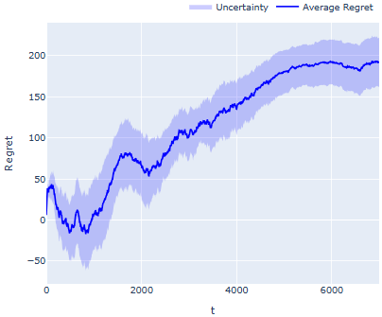
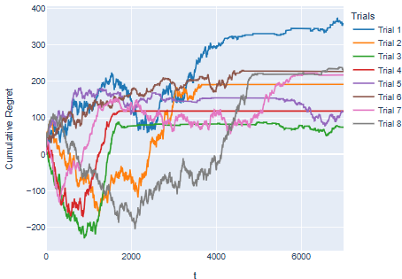
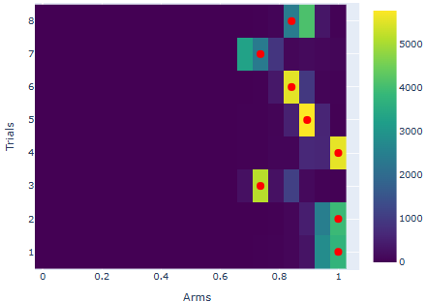
OLA - Project Assignment
N. Balestrieri, A. Bertogalli, F. Cavalieri, N. Tombini
Adversarial environment - Pricing Hedge
Here we employ Hedge on discretized set of prices $p∈[0,1]$ considering the following parameters: the cost c = 0.3, the number of rounds T = 7000, K = 20, the number of customer = 30. The execution have been made over 8 Trials.
Fig. 23 - The regret for every trial archived by Hedge
Fig. 24 - The average regret archived over 8 trials by Hedge.
Fig. 25 - The choosen prices for each trials by Hedge.

Slide 13
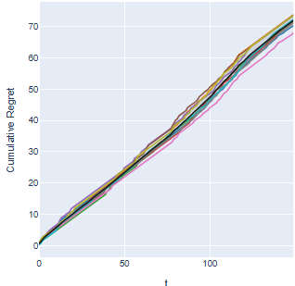
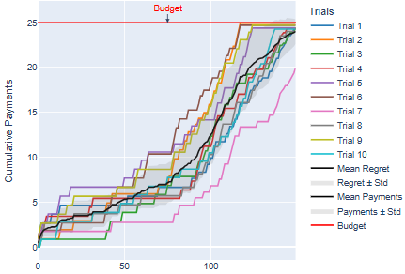
OLA - Project Assignment
N. Balestrieri, A. Bertogalli, F. Cavalieri, N. Tombini
Adversarial environment - Bidding Hedge (MPS)
Here we use an Hedge Multiplicative Pacing Strategy on the bidding problem in adversarial environment (shown in the previous slide). Here we consider the following parameters: the budget B = 25, 5 advertisers, 150 users, value = 0.4, slots = 3.
Fig. 26 - The regret for every trial archived by Hedge.
Fig. 27- The cumulative payments for each trial.

Slide 14
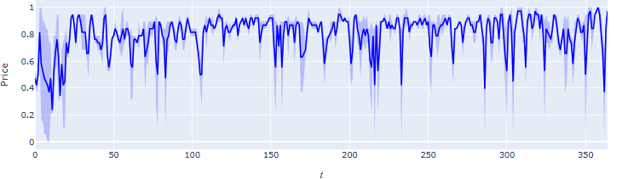
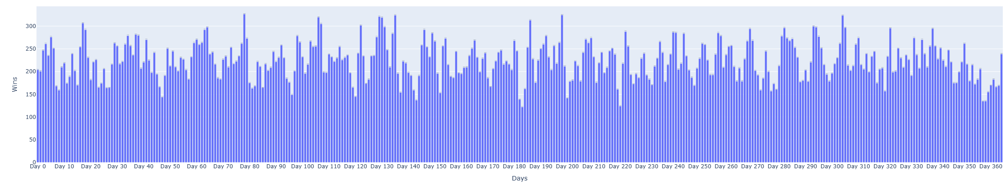
OLA - Project Assignment
N. Balestrieri, A. Bertogalli, F. Cavalieri, N. Tombini
Adversarial environment - Pricing + Bidding
Here we evaluate the interaction with parameters: advertisers = 3, slot = 3, users = 500 (auction per day), value=0.6, budget=120, days=365, trials=2, K=20, cost=0.4, using EXP3 for the pricing and Hedge for the bidding.
Fig. 28 - Here are represented the prices chosen by agent EXP3 during the campaign days.
Fig. 29 - Here are represented the wins per day obtained during the entire duration of the campaign.

Slide 15
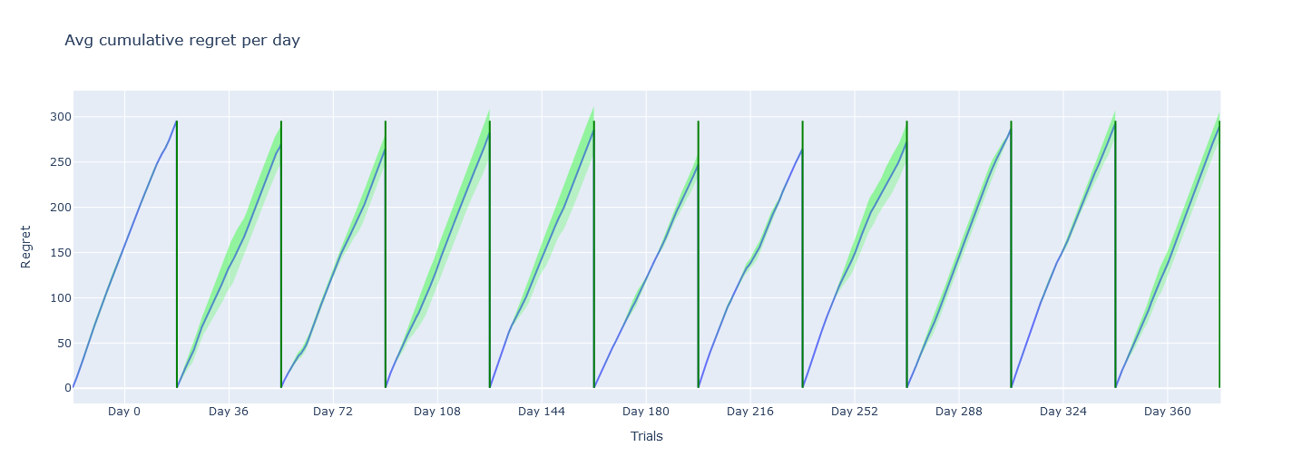
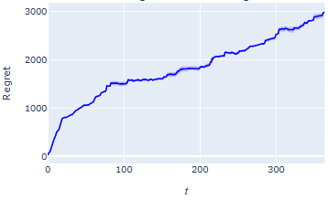
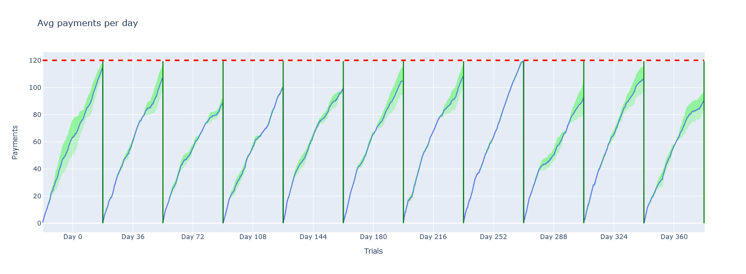
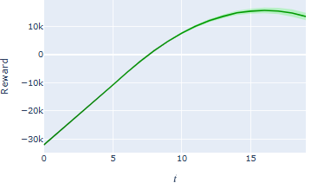
OLA - Project Assignment
N. Balestrieri, A. Bertogalli, F. Cavalieri, N. Tombini
Adversarial environment - Pricing + Bidding
Here we evaluate the interaction with parameters: advertisers = 3, slot = 3, users = 500 (auction per day), value=0.6, budget=120, days=365, trials=2, K=20, cost=0.4.
Fig. 30 - Here we show the bidding performances in 10 days in the years in terms of regret and payments.

Slide 16
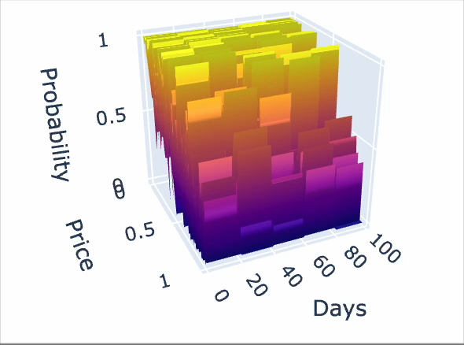
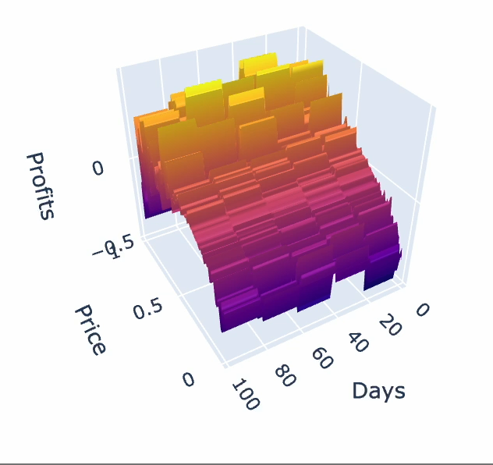
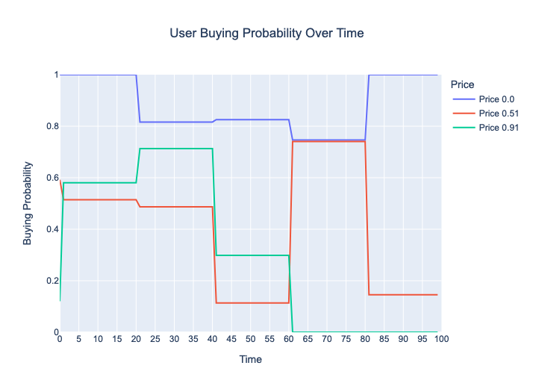
OLA - Project Assignment
N. Balestrieri, A. Bertogalli, F. Cavalieri, N. Tombini
Non-stationary environment - The setting
Here we are considering a non-stationary environment for the pricing problem. In particular days are partitioned in intervals, in each interval the demand curve is different. The demand curve with noise specifies how many buyers will buy for every price depending on the current interval. We focus on building a pricing strategy using the discretization of the prices $p∈[0,1]$. To handle non-stationarity we employ Sliding-Window and CUSUM.
Fig. 31 - The demand curve expression: $D(t)=(1-p)$ $+N(0,0.30)$ where the noise is sampled every 20 rounds.
Fig. 33 - User’s buying probability over time considering three possible prices
Fig. 32 - The profit curve

Slide 17
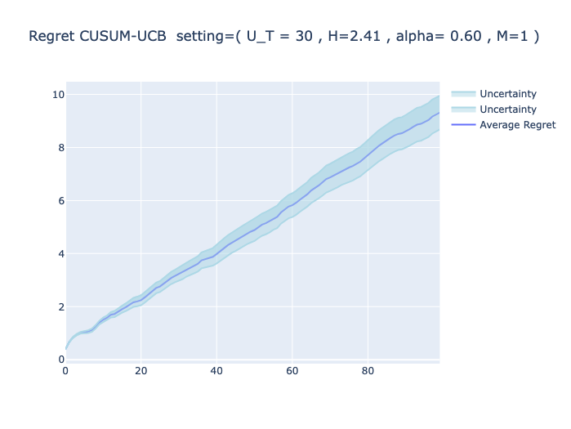
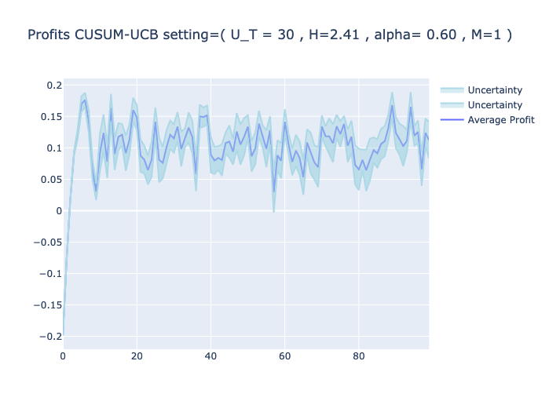
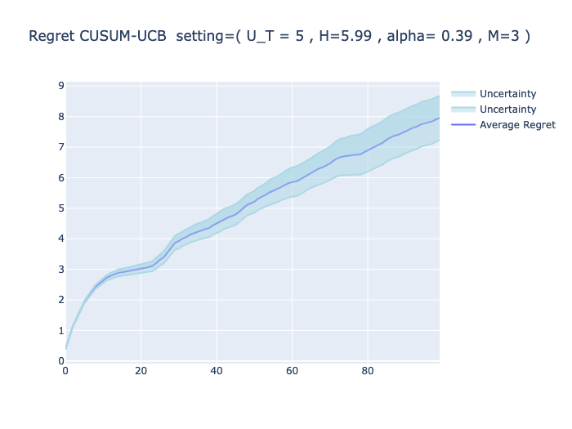
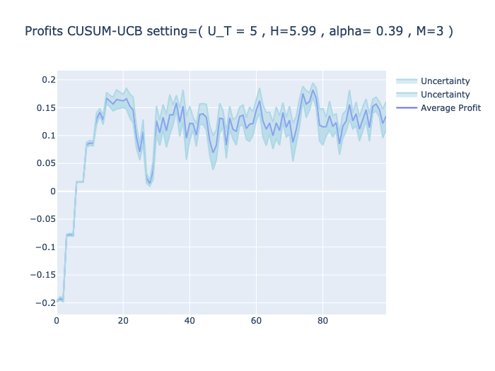
OLA - Project Assignment
N. Balestrieri, A. Bertogalli, F. Cavalieri, N. Tombini
Non-stationary environment - CUSUM
Here we are considering the CUSUM-UCB Algorithm. We used the same non-stationary environment setting but changed the price discretization by using a linear-space with $K=10$, we considered two different cases:
One overestimating the number of abrupt changes ($Υ_{T}=30$)
One knowing a priori the number of abrupt changes ($Υ_{T}=5$)
$$t$$
Fig. 34 - $H=2.41$, $α=0.6$, $M=1$.
$$α=\sqrt{Υ_{T}⋅\frac{log(\frac{T}{Υ_{T}})}{T}}$$
$$H=2*log(\frac{T}{Υ_{T}})$$
$$M=log(\frac{T}{Υ_{T}})$$
Fig. 35 - $H=5.99$, $α=0.39$, $M=3$.

Slide 18
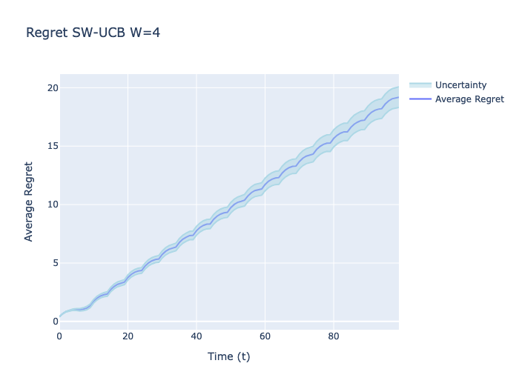
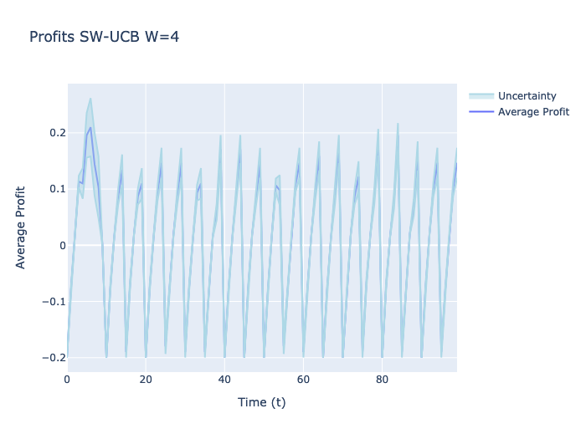
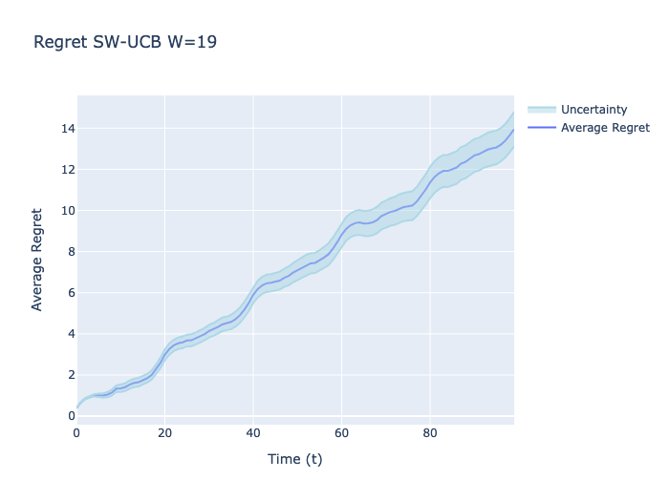
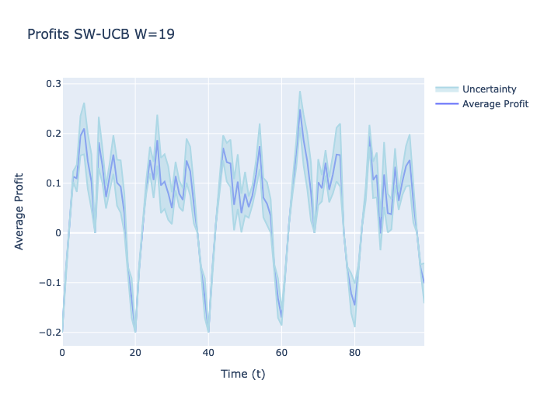
OLA - Project Assignment
N. Balestrieri, A. Bertogalli, F. Cavalieri, N. Tombini
Non-stationary environment - Sliding Window
Here we are considering the Sliding Window - UCB Algorithm, using the same non-stationary setting but changing the price discretization by using a linear-space with $K=10$ we considered two different cases:
Knowing a priori the number of abrupt changes
$W=⌊2B\sqrt{\frac{TlogT}{Υ_{T}}}⌋$, $Υ_{T}=5$
no prior information
$W=⌊2B\sqrt{\frac{TlogT}{Υ_{T}}}⌋$, $Υ_{T}=T$
$$t$$
Fig. 36 - $W=4,Υ_{T}=T$
Fig. 37 - $W=19,Υ_{T}=5$

Slide 19
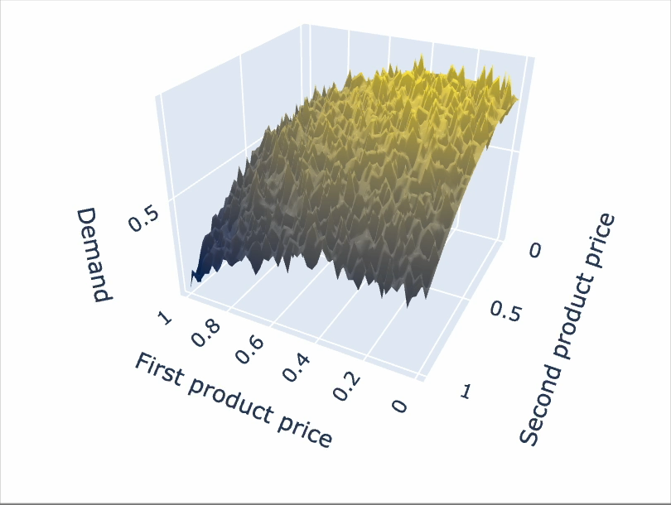
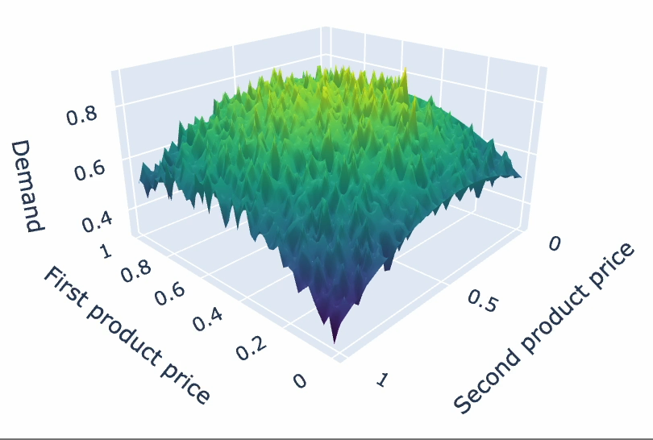
OLA - Project Assignment
N. Balestrieri, A. Bertogalli, F. Cavalieri, N. Tombini
Non-stationary environment - Two products
Here we are considering a two-item stochastic pricing environment. In particular, the seller proposes two items $i_{1}$ and $i_{2}$ the demand curve $D(p_{1},p_{2})$ is a two variable function + noise that specifies how many buyers will buy product $i_{1}$and how many will buy product $i_{2}$depending on price $p_{1}$ of product $i_{1}$ and price $p_{2}$ of product $i_{2}$.
Fig. 38 - $D(t)=-0.8⋅\left((p_{1}-0.4)^{2}+(p_{2}-0.6)^{2}\right)+1.0$ $+N(0,0.04)$ the demand curve for the product 1.
Fig. 39 - $D(t)=-0.8⋅\left((p_{1}-0.2)^{2}+(p_{2}-0.3)^{2}\right)+1.0$ $+N(0,0.04)$ the demand curve for the product 2.

Slide 20
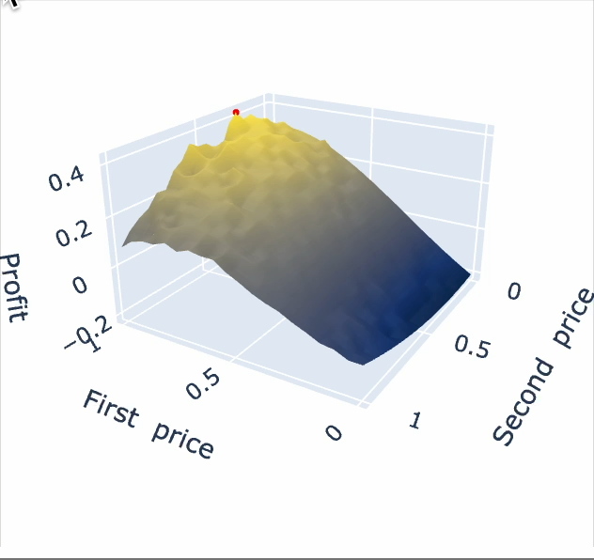
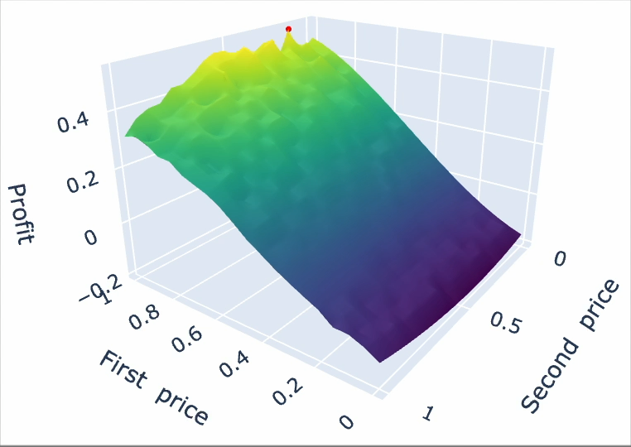
OLA - Project Assignment
N. Balestrieri, A. Bertogalli, F. Cavalieri, N. Tombini
Non-stationary environment - Two products
Here we are considering a two-item stochastic pricing environment. In particular, the seller proposes two items $i_{1}$ and $i_{2}$ the demand curve $D(p_{1},p_{2})$ is a two variable function + noise that specifies how many buyers will buy product $i_{1}$ and how many will buy product $i_{2}$ depending on price $p_{1}$ of product $i_{1}$ and price $p_{2}$ of product $i_{2}$.
Fig. 40 - The profit curve for the product 1.
Fig. 41 - The profit curve for the product 2.

Slide 21
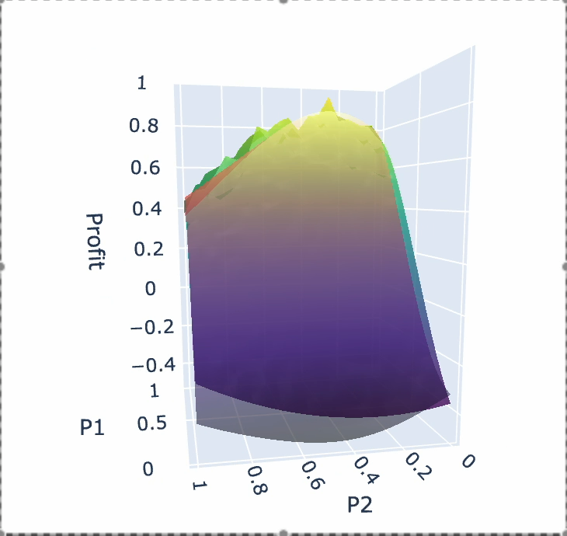
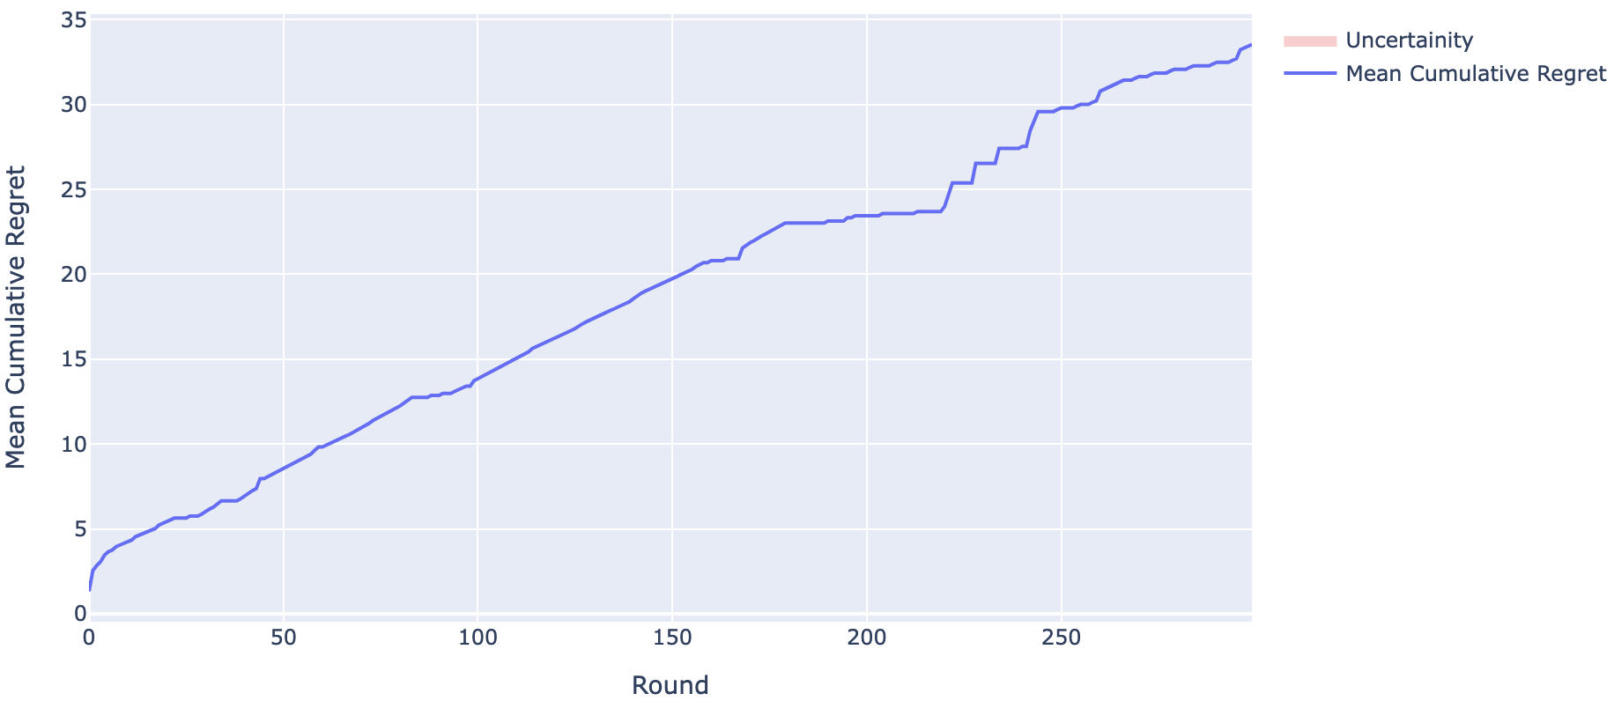
OLA - Project Assignment
N. Balestrieri, A. Bertogalli, F. Cavalieri, N. Tombini
Non-stationary environment - Two products results
To model this type of enviroment we used a Gaussian UCB approach, using a Gaussian Regressor to estimate the profit curve, optimizing it along the couple of price $p_{1}$, $p_{2}$that were be used as arms. This type of approach permitted us to use the same pipeline used at with one product even if the problem has 2 different products.
The settings of this approach are :
- Trials = 1
- T = 300
Trials = 1, T = 300, Cost = 0.3
Trials = 1, T = 300, Cost = 0.3
Fig. 42 - Estimated profit curve.
Fig. 43 - GP-UCB cumulated regret.

Slide 22
OLA - Project Assignment
N. Balestrieri, A. Bertogalli, F. Cavalieri, N. Tombini
Competition among algorithms - The setting
The goal here is to compare the performances of different bidding algorithms, competing over a Generalized First Price Auction, in particular we considered 3 algorithms:
A primal-dual algorithm for truthful auctions (Multiplicative Pacing Strategy)
A primal-dual algorithm for non-truthful auctions (Hedge Multiplicative Pacing)
A UCB-like approach (UCB-Like Multiplicative Pacing)
We also evaluated different parameters for the algorithms i.e. we tried different valuations for each algorithm. The parameters considered are:
SLOTS | TRIALS | BUDGET | VALUATIONS | K | USERS
2 | 5 | 100 |  | 10 | 600
$$v∈\{0.3,0.5\}$$
Fig. 44 - The considered parameters.

Slide 23



OLA - Project Assignment
N. Balestrieri, A. Bertogalli, F. Cavalieri, N. Tombini
Competition among algorithms - Comparison
Here we compare the results of the competition among algorithms:
Fig. 45 - Cumulative regret per algorithm.
Fig. 46 - Cumulative reward per algorithm.
Fig. 47 - Cumulative payments per algorithm.

Slide 24
Thanks
Authors:
Balestrieri Niccolò, Bertogalli Andrea, Cavalieri Francesco, Tombini Nicolò
Professors:
Matteo Castiglioni, Gianmarco Genalti
Accademic year 2024/2025

